Slide 1
Smokefree Sidelines Campaign
Public Heath Team, Buckinghamshire Council
Nicola.Coote@buckinghamshire.gov.uk

Slide 2
What is Smokefree Sidelines?
Smokefree Sidelines is a collaboration between Buckinghamshire Public Health and the Bucks & Berks Football Association (FA)
Smokefree Sidelines is not about targeting smokers unfairly. It encourages smokers to either refrain from smoking during a match or to move away from the sidelines and smoke where they are not visible and children and young adults are not present
It is a campaign which launched in January 2022, aiming to:
introduce a culture of smokefree sidelines across Buckinghamshire
encourage harm reduction to those exposed to smoking
1
4
2
3
It supports smokers to know where they can access help to quit smoking

Slide 3
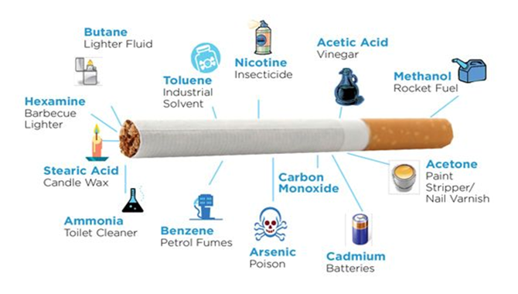
Smoking in Buckinghamshire
Smoking is the biggest behavioural cause of preventable illness and premature deaths in Buckinghamshire
It often starts as a childhood addiction - evidence has shown that most adult smokers started smoking at a young age
Children and young people are at risk if they are exposed to second-hand smoke and are most at risk of becoming smokers themselves if they grow up in communities where smoking is the norm

Slide 4
Background
1
2
3
4
Oxfordshire County Council sent a survey to local football clubs asking for views on smoking along football pitch sidelines, when children and young people were playing or training
86% of respondents found smoking at the sidelines when children and young people were playing or training to be unacceptable
Thus, Smokefree Sidelines in Oxfordshire was launched, and more than 30 clubs signed up
Buckinghamshire Council launched a similar survey and found:
92% (89 out of 97 respondents) believed that smoking at the sidelines was unacceptable
87% supported the idea of a campaign to encourage adults to not smoke/vape in public where they are visible to children
The Buckinghamshire Smokefree Sidelines campaign was launched in February 2022
Since then, 17 clubs have signed up
Council-owned pitches and playing fields are adding a smoke and vape-free condition to their booking forms by September 2024

Slide 5
Which clubs have joined to date?
Flackwell Heath FC Minors
Burnham Juniors FC
Holmer Green FC
Holy Trinity (Hazlemere) Junior FC
Wendover Juniors FC
Downley
Aylesbury United Juniors FC
Wingrave Wasps Junior FC
Aston Clinton Colts JFC
Beaconsfield Town Youth FC
Bourne End
Chalfont Saints FC
Gerrards Cross and Fulmer FC
Aylesbury Vale Dynamos
Haddenham Youth FC
Risborough Rangers
Penn and Tylers Green

Slide 6
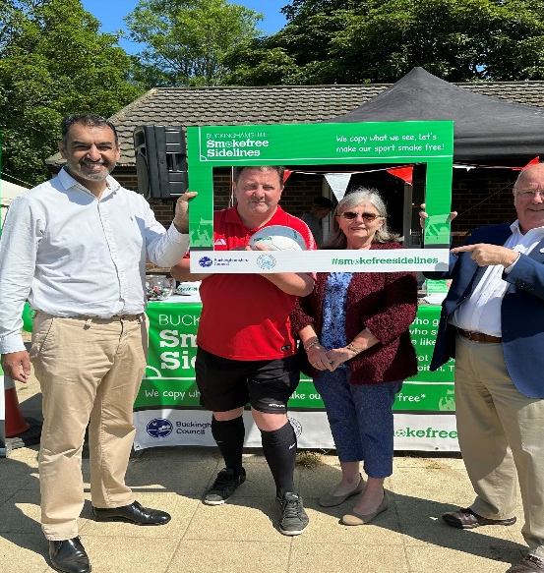
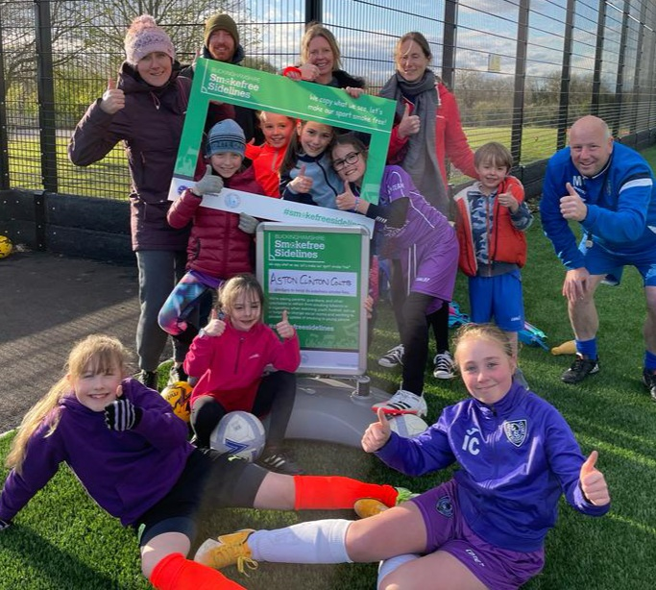
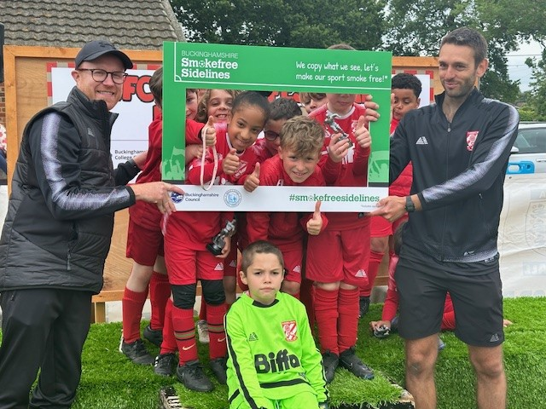
Campaign photos

Slide 7
Promotional materials
To support your club to promote and share the Smokefree Sidelines messaging, we are providing each signed club a standard pack of promotional materials. This will include:
Posters (A4/A2)
Barrier tape
Flyers/postcards to hand out to parents on the sidelines
Selfie board for pictures
On request only:
A-frame stand
Vinyl banners for railings/fencing

Slide 8
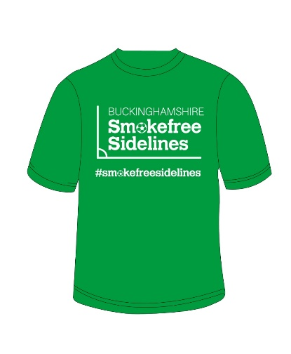
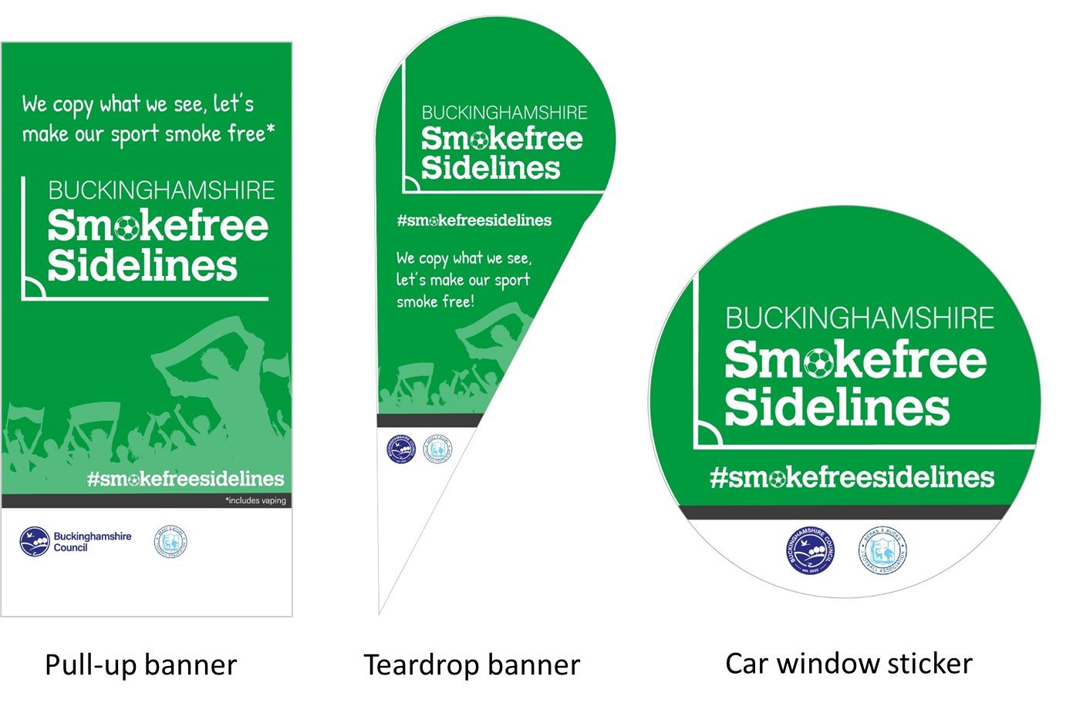
Promotional material images
Postcard
T-shirt
Selfie frame
PVC banner

Slide 9
How do we measure impact?
Your Thoughts survey responses
Pre-assessment checklist responses from participating clubs
Before and after images of/ information on smoking/ vaping debris from participating clubs
Notes:
Your Thoughts survey responses:
From February 2022 this survey was sent to clubs signed up to Smokefree Sidelines, and forwarded to their club members
Pre-assessment check responses from participating clubs:
Upon signing up, each club was asked to complete a pre-evaluation checklist to establish their current smoking/vaping situation
Before and after images of/ information on smoking/ vaping debris from participating clubs:
Upon signing up each club was asked to take smoking/ vaping related images, and again six months later to evaluate the visible impact of the campaign
Before and after images of/ information on ‘No-Smoking’ signage:
Upon signing up each club was asked to take ‘No Smoking’ signage images, and again six months later to evaluate the visible impact of the campaign

Slide 10
Conclusion
Only 3 out of 97 respondents to the Buckinghamshire Council ‘Your Thoughts’ survey (taken between February 2022 and February 2023) believed smoking at football club sidelines when children and young people played or trained was acceptable.
Yet 25 respondents saw parents/supporters smoking at the sidelines of matches occasionally or more.

